Slide 1
Confidence intervals

Slide 2

Statistical inference is all about using a sample to estimate “something” about the population
The target parameter can be mean, variance, and many other characteristics about the population
In this module, our focus will be on estimating:
the population mean
To do that, it may sometimes require we estimate population variance as well

Slide 3

To proceed, we will assume that the population follows a certain distribution (i.e., the statistical model)
Then, a random sample is used to make inference about certain properties of the distribution
Statistical model/population
Random sample (iid)
$$X\sim N\left(??,??\right)$$

Slide 4
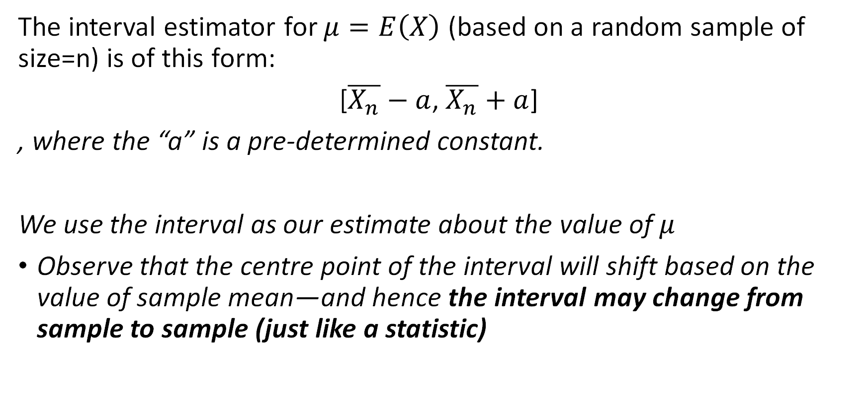
Interval estimator for E(X)
The interval estimator for $μ=E\left(X\right)$ (based on a random sample of size=n) is of this form:
[$\overline{X_{n}}−a$, $\overline{X_{n}}+a$]
, where the “a” is a pre-determined constant.
We use the interval as our estimate about the value of $μ$
Observe that the centre point of the interval will shift based on the value of sample mean—and hence the interval may change from sample to sample (just like a statistic)

Slide 5

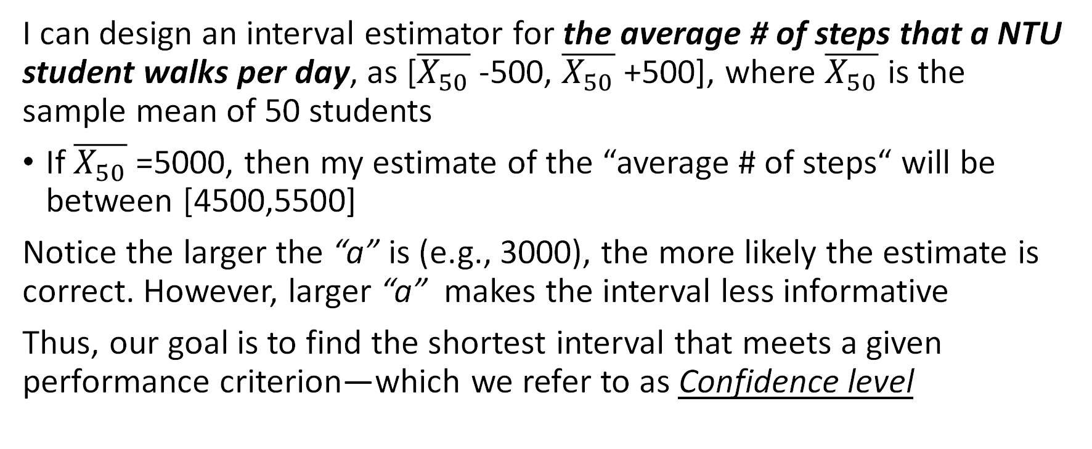
Example: How many steps per day?
I can design an interval estimator for the average # of steps that a NTU student walks per day, as [$\overline{X_{50}}$ -500, $\overline{X_{50}}$ +500], where $\overline{X_{50}}$ is the sample mean of 50 students
If $\overline{X_{50}}$ =5000, then my estimate of the “average # of steps“ will be between [4500,5500]
Notice the larger the “a” is (e.g., 3000), the more likely the estimate is correct. However, larger “a” makes the interval less informative
Thus, our goal is to find the shortest interval that meets a given performance criterion—which we refer to as Confidence level

Slide 6
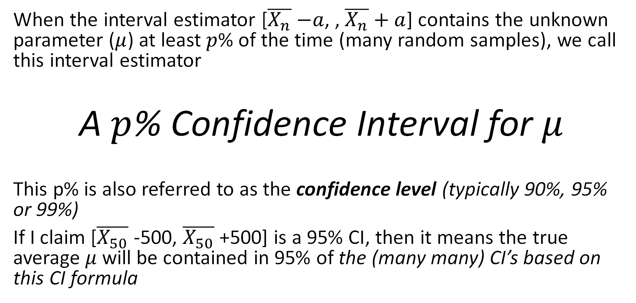
Confidence level and confidence interval (CI) for E(X)
When the interval estimator [$\overline{X_{n}}$ $−a$, , $\overline{X_{n}}+a$] contains the unknown parameter ($μ$) at least $p$% of the time (many random samples), we call this interval estimator
A $p$% Confidence Interval for $μ$
This p% is also referred to as the confidence level (typically 90%, 95% or 99%)
If I claim [$\overline{X_{50}}$ -500, $\overline{X_{50}}$ +500] is a 95% CI, then it means the true average $μ$will be contained in 95% of the (many many) CI’s based on this CI formula

Slide 7
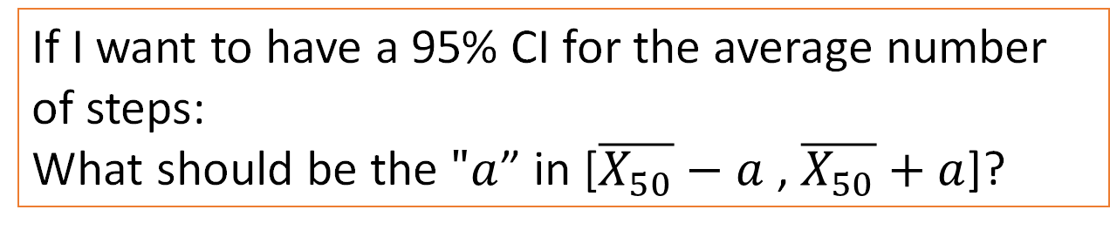
The learning objective of this week: For a given confidence level (90%, 95%, or 99%), Find out the right “a” for the CI formula
If I want to have a 95% CI for the average number of steps:
What should be the $"a$” in [$\overline{X_{50}}−a$ , $\overline{X_{50}}+a$]?

Slide 8
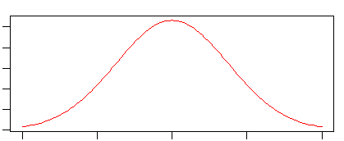

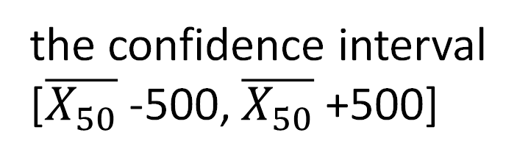
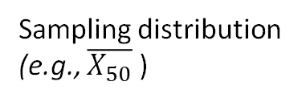
the confidence interval
[$\overline{X_{50}}$ -500, $\overline{X_{50}}$ +500]
Sampling distribution
(e.g., $\overline{X_{50}}$ )
Question: How does E(X) (the fish) relate to $\overline{X_{50}}$ ?

Slide 9

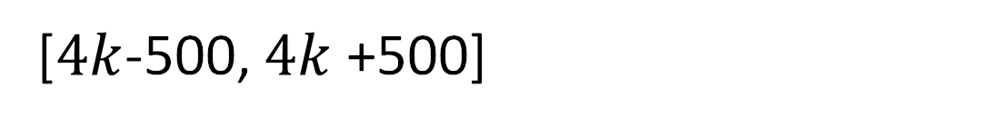
Sampling distribution
(e.g., $\overline{X_{50}}$ )
[$4k$-500, $4k$ +500]
$$\overline{X_{50}}=4k$$

Slide 10

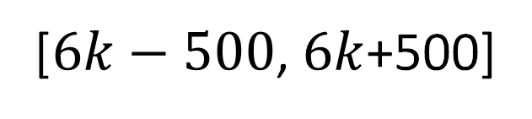
Sampling distribution
(e.g., $\overline{X_{50}}$ )
[$6k−500$, $6k$+500]
$$\overline{X_{50}}=6k$$

Slide 11

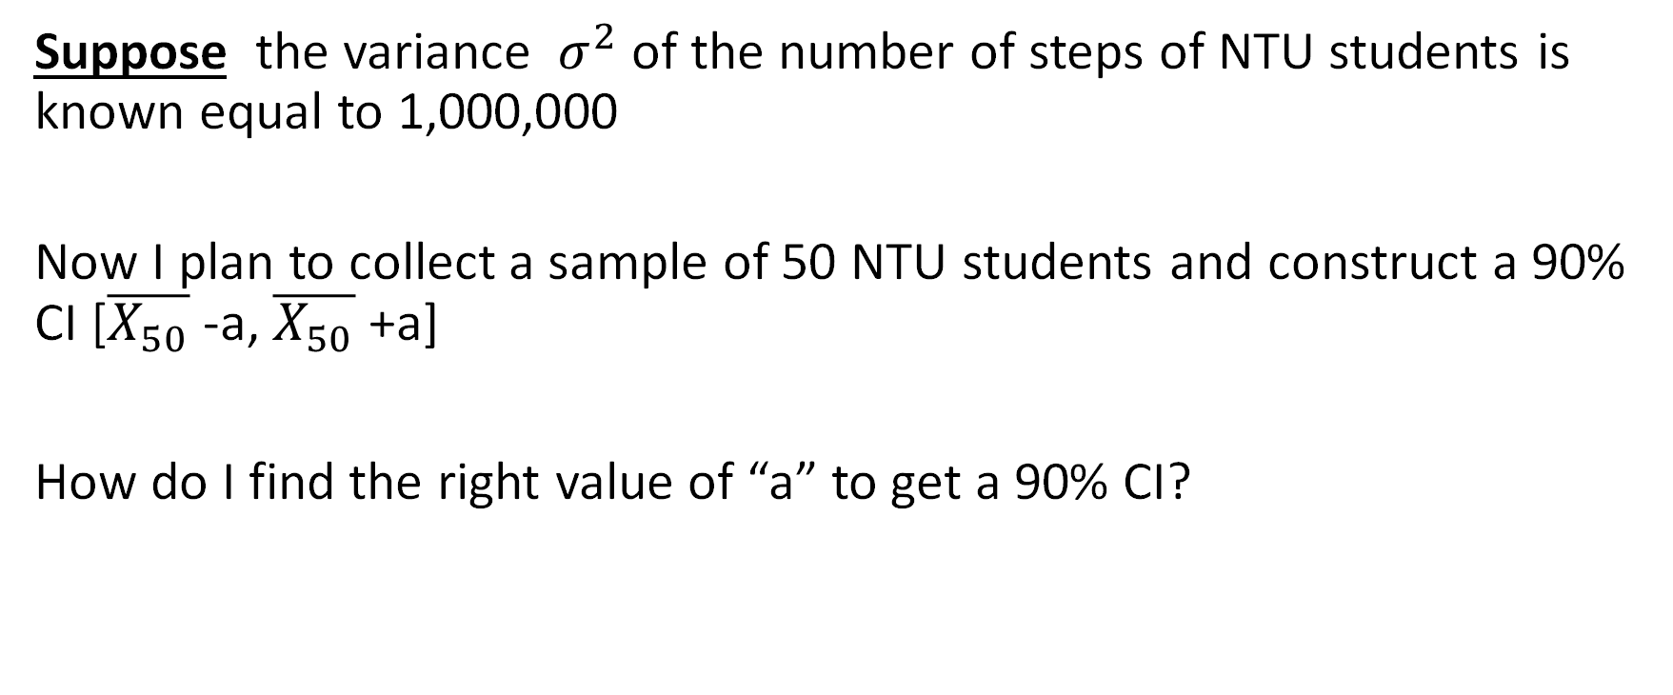
CI for $μ$when ${ σ}^{2}$ is known
Suppose the variance ${ σ}^{2}$ of the number of steps of NTU students is known equal to 1,000,000
Now I plan to collect a sample of 50 NTU students and construct a 90% CI [$\overline{X_{50}}$ -a, $\overline{X_{50}}$ +a]
How do I find the right value of “a” to get a 90% CI?

Slide 12





How to choose the “$a$” for the 90% confidence level?
Observe that $μ$ will be inside the CI when either {$\overline{X_{50}}≥μ−a\}$ or {$\overline{X_{50}}≤μ+a\}$, which amounts to this condition:
{$μ−a≤\overline{X_{50}}≤μ+a$}
By CLT
Sampling dist of $\overline{X_{50}}\sim N(μ,\frac{1000k}{50})$
$$μ$$
[ $\overline{X_{50}}$ ]
a
a
[ $\overline{X_{50}}$ ]
a
a

Slide 13


This means, if I can find the “$a$” to make Pr{$μ−a≤\overline{X_{50}}≤μ+a$}=0.90, then this choice of “$a$” will make this CI a 90% CI
Sampling dist of $\overline{X_{50}}\sim N(μ,\frac{1000k}{50})$
90%
5%
5%
a
a

Slide 14
POP Quiz: If instead we want to get a 95% or 99% CI, what would be corresponding tail probabilities? (verify your answers after the video)
Sampling dist of $\overline{X_{50}}\sim N(μ,\frac{1000k}{50})$
95%?
99%?
?%
?%
a
a

Slide 15
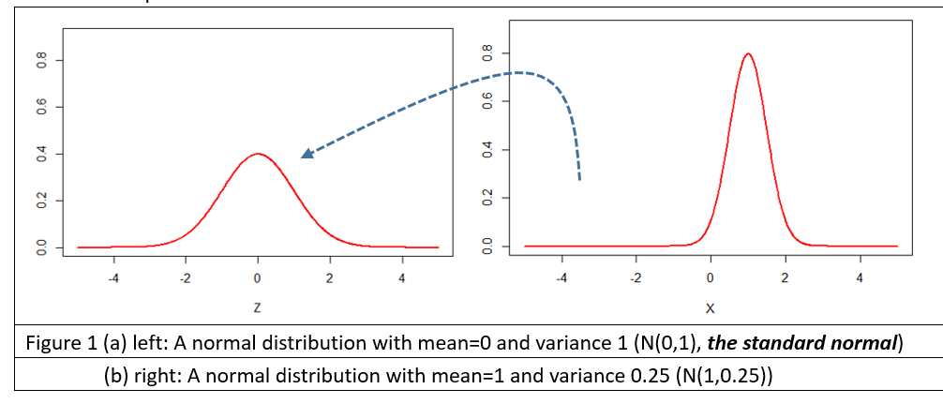
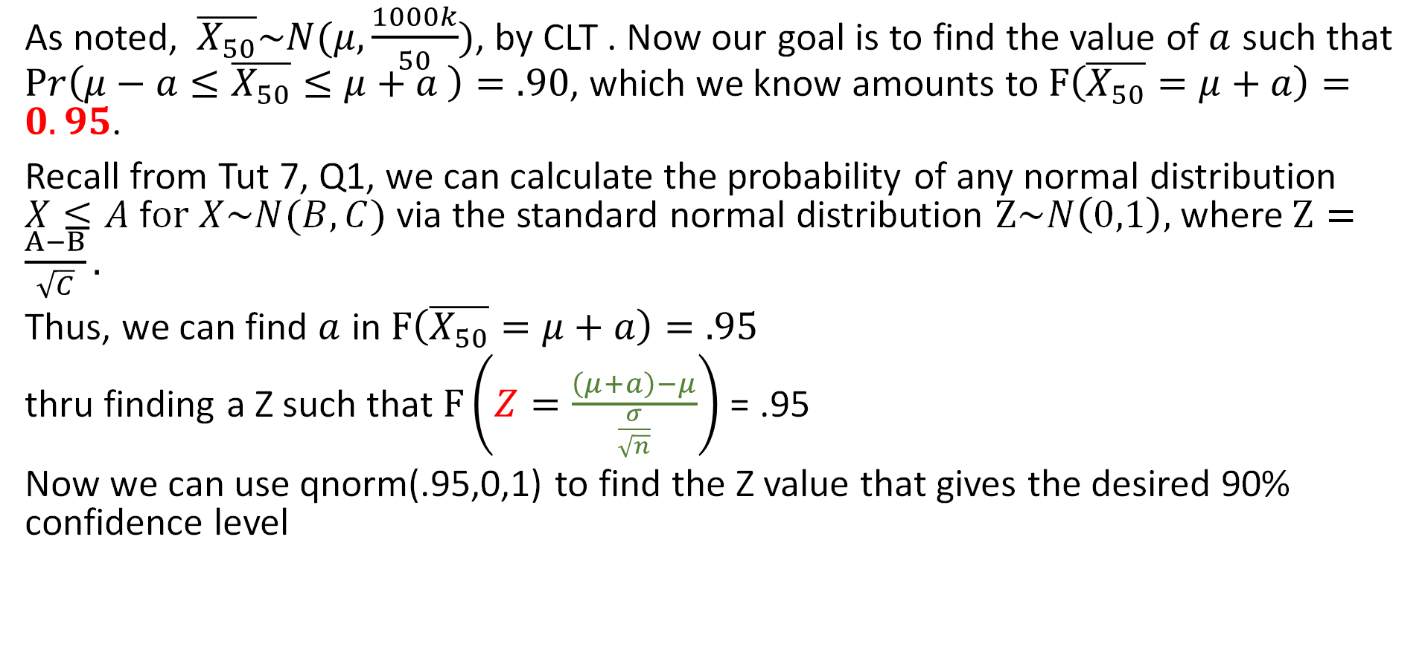
Steps to find “a”
As noted, $\overline{X_{50}}\sim N(μ,\frac{1000k}{50})$, by CLT . Now our goal is to find the value of $a$ such that $Pr\left(μ−a≤\overline{X_{50}}≤μ+a \right)=.90$, which we know amounts to $F\left(\overline{X_{50}}=μ+a\right)=0.95$.
Recall from Tut 7, Q1, we can calculate the probability of any normal distribution $X≤A$ f$or X\sim N(B,C)$ via the standard normal distribution $Z\sim N\left(0,1\right),$ where $Z=\frac{A−B}{\sqrt{C}}.$
Thus, we can find $a$ in $F\left(\overline{X_{50}}=μ+a\right)=.95$
thru finding a Z such that $F\left(Z=\frac{\left(μ+a\right)−μ}{\frac{σ}{\sqrt{n}}}\right)$ = .95
Now we can use qnorm(.95,0,1) to find the Z value that gives the desired 90% confidence level

Slide 16

Steps to finding “a”
$F\left(Z=\frac{\left(μ+a\right)−μ}{\frac{σ}{\sqrt{n}}}\right)$ = .95
$⇒$qnorm(.95,0,1)$=\frac{\left(μ+a\right)−μ}{\frac{σ}{\sqrt{n}}}$
$⇒a$ =qnorm(.95,0,1)$∗\text{(}\sqrt{\frac{1000k}{50}}$)=232.6174
$⇒$ Thus, the 90% confidence interval for this problem is [$\overline{X_{50}}−\text{232.6174}$, $\overline{X_{50}}+232.6174$].
For example, if $\overline{X_{50}}$=5000 for a sample, the 90% confidence interval will be [5k-232.6174,5k+232.6174
] = [4767.3826,5232.6174]

Slide 17
The p% CI is [$\overline{X_{n}}−z_{p′}∗\frac{σ}{\sqrt{n}}$, $\overline{X_{n}}+z_{p′}∗\frac{σ}{\sqrt{n}}$], p’=p+(100-p)/2 (%)
# Let’s review how the calculations can be done in R
> .90+(1-.90)/2
0.95
# Use “qnorm” to obtain the RV value corresponding to a cumulative probability
# The Lower and Upper Limits of the CI
>X_50=5000
>LL=X_50-qnorm(.95,0,1)*sqrt(1000000/50)
>UL=X_50+qnorm(.95,0,1)*sqrt(1000000/50)
[4767.383,5232.617]

Slide 18
The p% CI is [$\overline{X_{n}}−z_{p′}∗\frac{σ}{\sqrt{n}}$, $\overline{X_{n}}+z_{p′}∗\frac{σ}{\sqrt{n}}$], p’=p+(100-p)/2 (%)
# For a 99% CI
> .99+(1-.99)/2
0.995
# Use “qnorm” to obtain the RV value corresponding to a cumulative probability
# The Lower and Upper Limits of the CI
>X_50=5000
>LL=X_50-qnorm(.995,0,1)*sqrt(1000000/50)
>UL=X_50+qnorm(.995,0,1)*sqrt(1000000/50)
[4635.723, 5364.277]

Slide 19
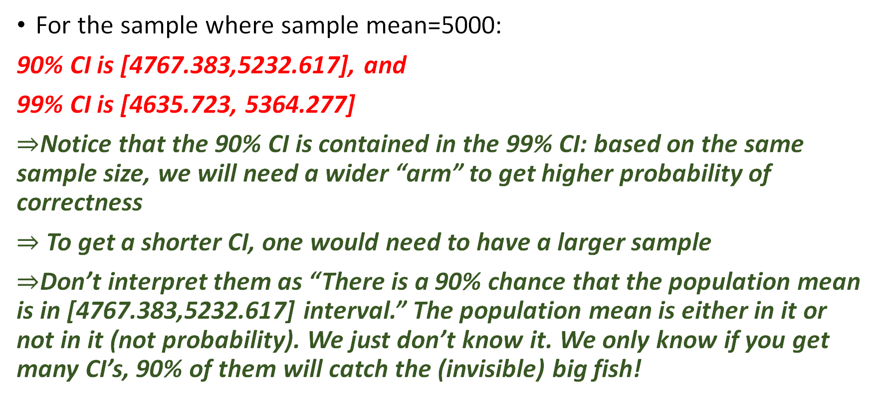
Some important facts from this example
For the sample where sample mean=5000:
90% CI is [4767.383,5232.617], and
99% CI is [4635.723, 5364.277]
$⇒$Notice that the 90% CI is contained in the 99% CI: based on the same sample size, we will need a wider “arm” to get higher probability of correctness
$⇒$ To get a shorter CI, one would need to have a larger sample
$⇒$Don’t interpret them as “There is a 90% chance that the population mean is in [4767.383,5232.617] interval.” The population mean is either in it or not in it (not probability). We just don’t know it. We only know if you get many CI’s, 90% of them will catch the (invisible) big fish!

